Slide 1
Introduction to Computer Graphics

Slide 2
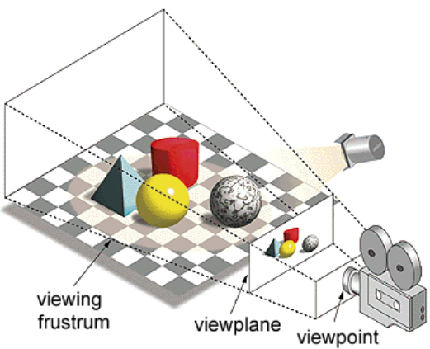
Computer Graphics
Model real world
Generate high quality 2d images efficiently, given the 3d model and camera parameters

Slide 3
Two Approaches
Rasterization
Faster
Pipelined
Ex. Real-time applications
Ray Tracing
High quality and More realistic
Ex. Animation movies

Slide 4
Rasterization Pipeline
Modeling Transformation
View Transformation
Illumination
Projection Transformation
Clipping
Rasterization or Scan conversion
Texturing

Slide 5
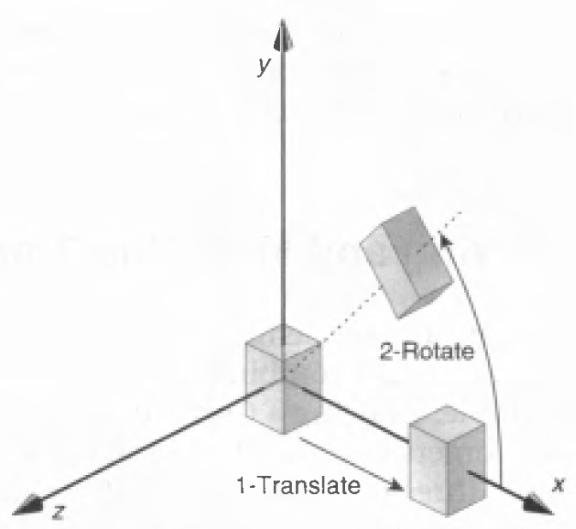
Modeling Transformation
Use transformation to position objects
Reuse objects

Slide 6
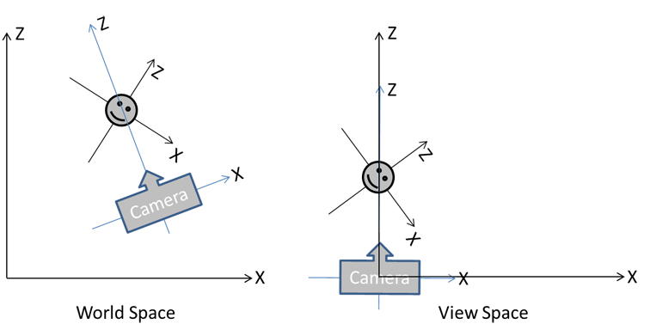
View Transformation
Translate camera to origin
Set view direction along a principal axis

Slide 7
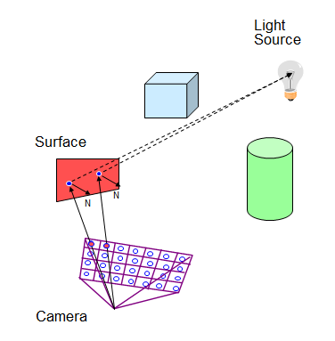
Illumination
Light the scene according to material properties of objects and light sources
Highly important to generate realistic image

Slide 8
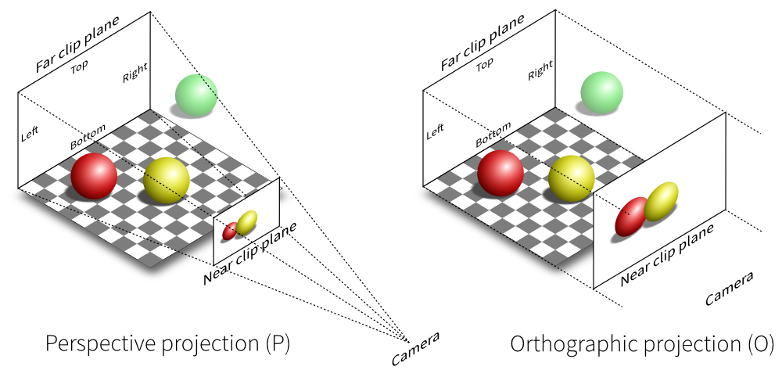
Projection and Clipping
Project the 3d model on a 2d screen
Clip objects outside viewing frustum

Slide 9
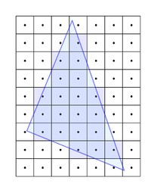
Rasterization
Determine which pixels to light on the screen

Slide 10
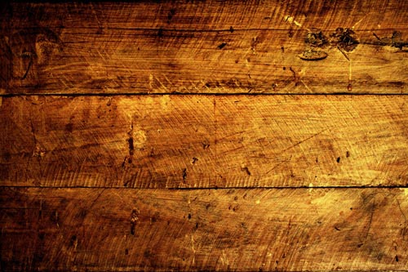
Texturing
Paste images on object surfaces

Slide 11
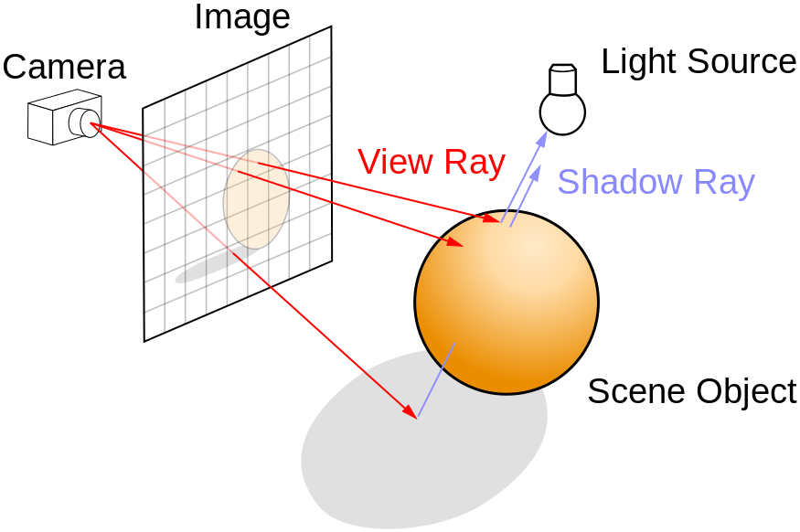
Ray Tracing
Cast rays from eye to each pixel to determine the color of pixel

Slide 12

Ray Tracing
Produces highly realistic image

Slide 13
More Topics
Hidden Surface Removal
Curves
Antialiasing

Slide 14
Textbooks
Computer Graphics: Principles and Practice in C (2nd Edition) by James D. Foley, Andries van Dam, Steven K. Feiner, John F. Hughes
Schaum's Outline of Computer Graphics (2nd Edition) by Zhigang Xiang, Roy A. Plastock
Computer Graphics using OpenGL (2nd edition) by Francis S Hill, Jr.

